Slide 1


Kotlin Basic Types
Booleans﻿

Slide 2
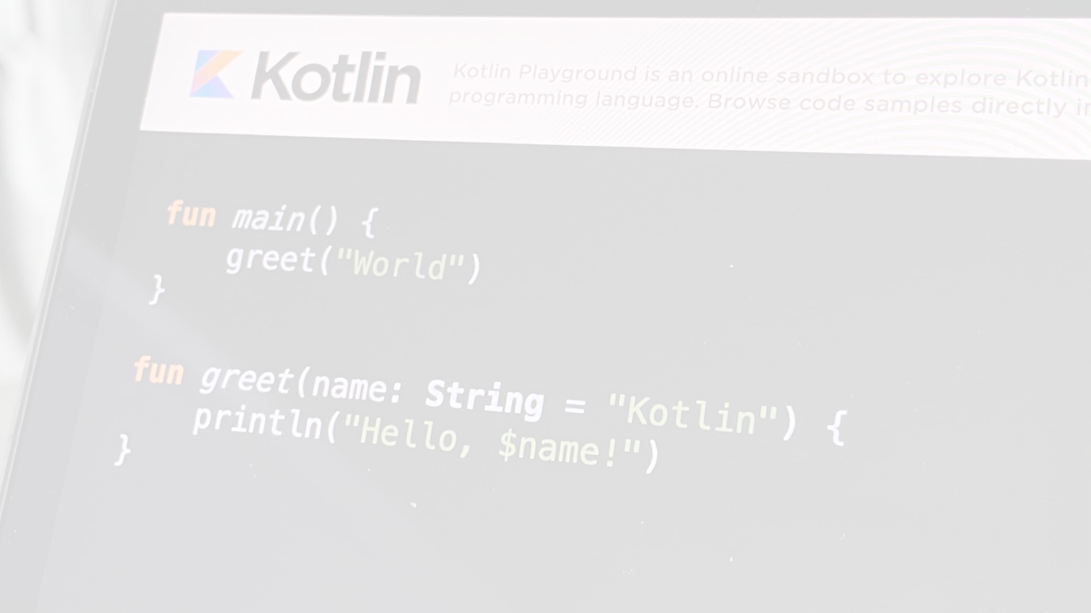
The type Boolean represents boolean objects that can have two values: true and false.
Boolean has a nullable counterpart Boolean? that also has the null value.
Built-in operations on booleans include:
|| – disjunction (logical OR)
&& – conjunction (logical AND)
! – negation (logical NOT)
|| and && work lazily.
val myTrue: Boolean = true
val myFalse: Boolean = false
val boolNull: Boolean? = null
println(myTrue || myFalse) // true
println(myTrue && myFalse) // false
println(!myTrue) // false

Slide 3
fun main() {
val isSunny = true
val isWarm = false
// Using logical AND
val isSunnyAndWarm = isSunny && isWarm
println("Is it sunny and warm? $isSunnyAndWarm")
// Using logical OR
val isSunnyOrWarm = isSunny || isWarm
println("Is it either sunny or warm? $isSunnyOrWarm")
// Using logical NOT
val isNotSunny = !isSunny
println("Is it not sunny? $isNotSunny")
}

Slide 4
Functions can also return boolean values.
fun isEven(number: Int): Boolean {
return number % 2 == 0
}
fun main() {
val num1 = 10
val num2 = 7
println("$num1 is even: ${isEven(num1)}")
println("$num2 is even: ${isEven(num2)}")
}

